Slide 1
SPEECH EMOTION RECOGNITION USING DEEP LEARNING
Team-06

Slide 2
TEAM MEMBERS:
S.NO | REG. NO. | NAME
1 | 2019103557 | PRATHIBA.D
2 | 2019103569 | RAMYA.P
3 | 2019103572 | ROHITH KUMAR. M
4 | 2019103578 | ABHIMANYU. S.G.

Slide 3
PROBLEM STATEMENT
In this rapidly advancing AI world, human computer interactions (HCI) are of extreme importance. We live in a world where Siri and Alexa are physically closer to us than other humans. Soon the world will get more populated with physical and virtual service robots to accomplish tasks that range from caring for the elderly to assessing the effectiveness of our marketing campaign. Understanding human emotions paves the way to understanding people's needs better and ultimately, providing better service. Speech emotion recognition can be applied in marketing, healthcare, customer satisfaction, gaming experience improvement, social media analysis, stress monitoring and much more.
OBJECTIVE
The primary objective of Speech Emotion Recognition is to improve man-machine interface. Our project aims to investigate and implement an Artificial Intelligence (AI) algorithm that will analyse an audio file in real-time, identify and present the expressed emotion within it. It can be used to monitor the psycho physiological state of a person in lie detectors. It also finds its applications in medicine and forensics.

Slide 4
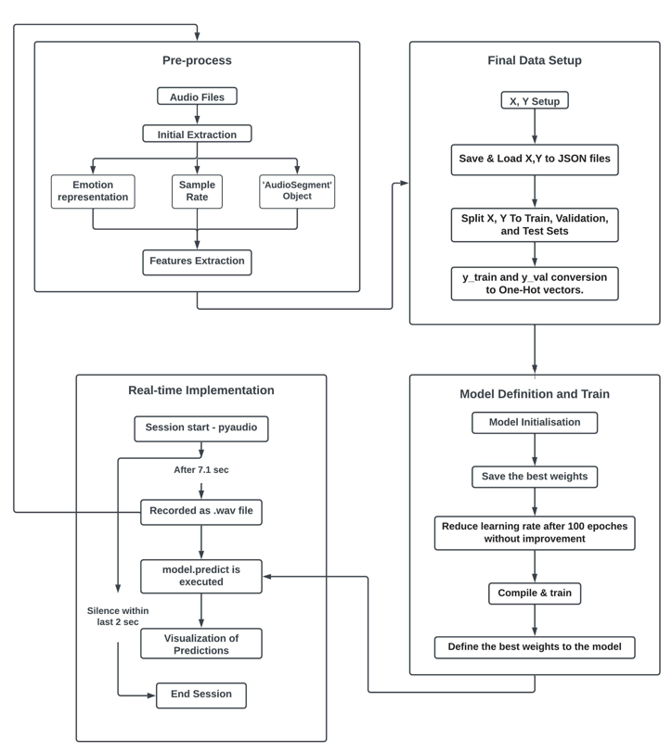
SYSTEM ARCHITECTURE

Slide 5
MODULES
1- PREPROCESSING
Priorly in preprocessing, the emotion representation is done based on the dataset chosen.
The sample rate is calculated.
The audio is then processed as follows:
(i) The audio is loaded to an object by the AudioSegment module of pydub.
(ii) The 'AudioSegment' object is normalized to + 5.0 dBFS.
(iii) Transforming the object to an array of samples.
(iv) Trimming the silence in the beginning and the end.
(v) Padding every audio file to the maximum length
(vi) Noise reduction
Then the feature extraction is carried out
Root Mean Square (RMS), Zero Crossed Rate (ZCR), Mel-Frequency Cepstral Coefficients (MFCCs) are extracted.

Slide 6
Input: Audio datasets
Output: Features extracted(RMS,ZCR,MFCCs)
2- FINAL DATA SETUP
Before fitting the data into the model some changes are made.
The shapes of the features are kept uniform and in 3D format.
Concatenating all features to a single variable.
Preparing another variable with a 2D shape.
Split both variable into test ,validation and train sets
Convert both train and validation sets of 2D data into one-hot vector
Input: Features extracted from preprocessing.
Output: Test, train and validation sets

Slide 7
3- MODEL TRAINING AND EVALUATION
Initialising the model.
Saving the best weights is essential as they are finally defined to the model.
Reduction of the rate of training after 100 epochs.
The saved weights are now defined to the model.
Model evaluation is done over the validation and test sets
Input: Test, train and validation sets
Output: Prediction Accuracy Rates
4- REAL TIME IMPLEMENTATION
The voice input is received from a microphone and stored as a .wav file.
In this module the recording of the sound is done for a particular time and then an iteration happens for timesteps number of times to insert frames to the ‘.wav' file.
(Timesteps=Rate/Chunk*Time_recorded)

Slide 8
After recording, Model's prediction is done with an 8 emotion probabilities array.
Finally, emotion distribution is presented for the whole sequence.
Input: The voice recording of a person.
Output: The emotion distribution of the recording, throughout the time it was recorded.
DATASET DESCRIPTION
The speech emotion audio databases to be used are:
The Ryerson Audio-Visual Database of Emotional Speech and Song (RAVDESS) https://zenodo.org/record/1188976#.X4sE0tDXKUl
The Ryerson Audio-Visual Database of Emotional Speech and Song (RAVDESS) was recorded with 24 professional actors (12 female, 12 male), vocalizing two lexically-matched statements in a neutral North American accent. Each expression is produced at two levels of emotional intensity (normal, strong), with an additional neutral expression.
1440 files = 24 actors x 60 trails per actor
8 Emotions (neutral, calm, happy, sad, angry, fearful, disgust, surprised).

Slide 9
Toronto Emotional Speech Set (TESS) https://tspace.library.utoronto.ca/handle/1807/24487
A set of 200 target words were spoken in the carrier phrase "Say the word _' by two actresses (aged 26 and 64 years) and recordings were made of the set portraying each of seven emotions described below.
2800 files = 2 actors x 200 pharses x 7 emotions
7 Emotions (neutral, happiness, sadness, anger, fear, disgust, pleasant surprise)
('calm' is not a part of this DB)
PERFORMANCE MEASURES :
The model has been evaluated using the following factors:
A visualization of the loss and categorial accuracy values trend during the train process.
A confusion matrix for visualizing the number of successful predictions of each emotion: for validation and test sets.
Model's prediction accuracy rates for each emotion: for validation and test sets.

Slide 10
REFERENCES:
https://ieeexplore.ieee.org/document/8805181
https://www.irjet.net/archives/V7/i6/IRJET-V7I6804.pdf
https://ieeexplore.ieee.org/document/9641642
https://www.analyticsinsight.net/speech-emotion-recognition-ser-through-machine-learning/
https://vivoka.com/how-to-speech-emotion-recognition/

Slide 11
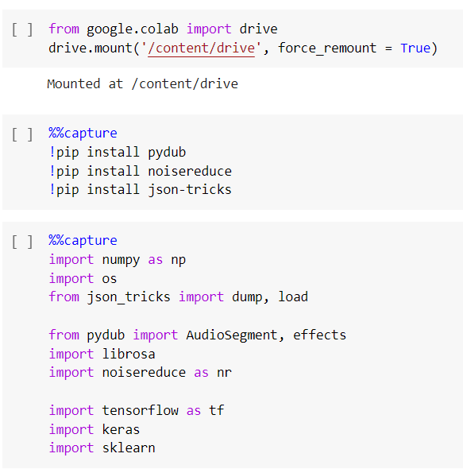
IMPLEMENTATION
Importing required python packages

Slide 12
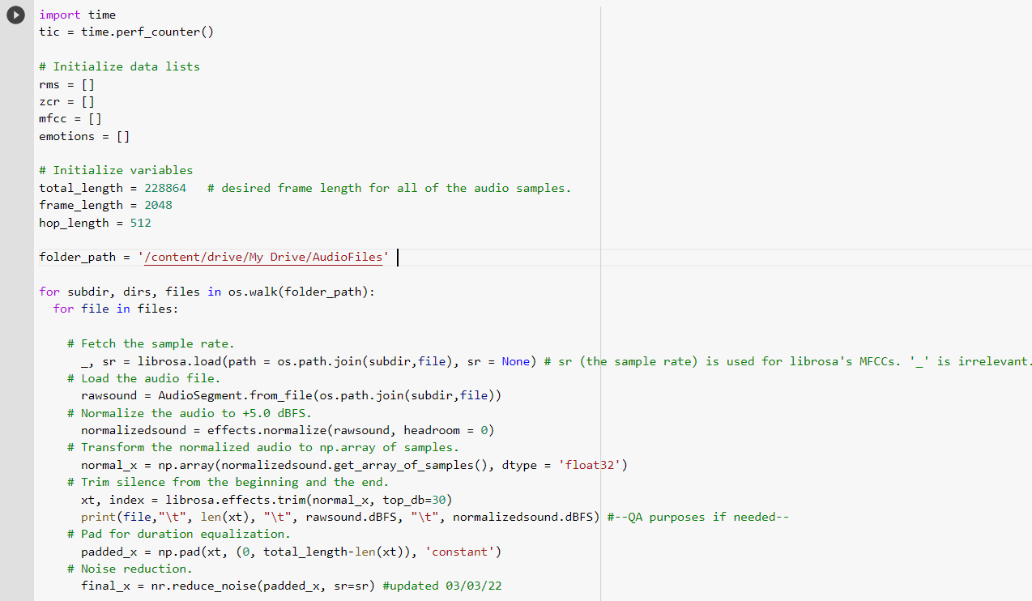
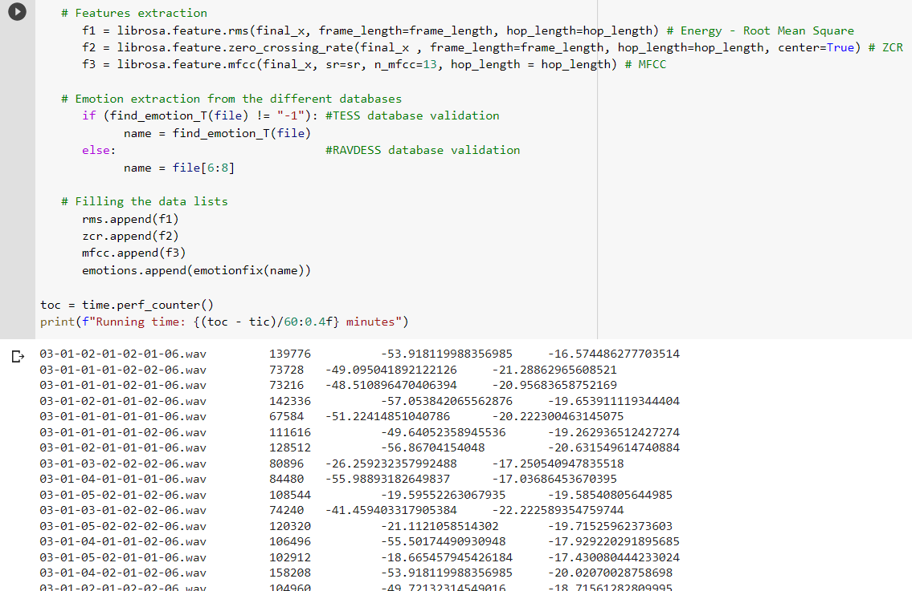
Loading and Normalising the audio files
Features extraction (rms,mfcc and zcr)

Slide 13
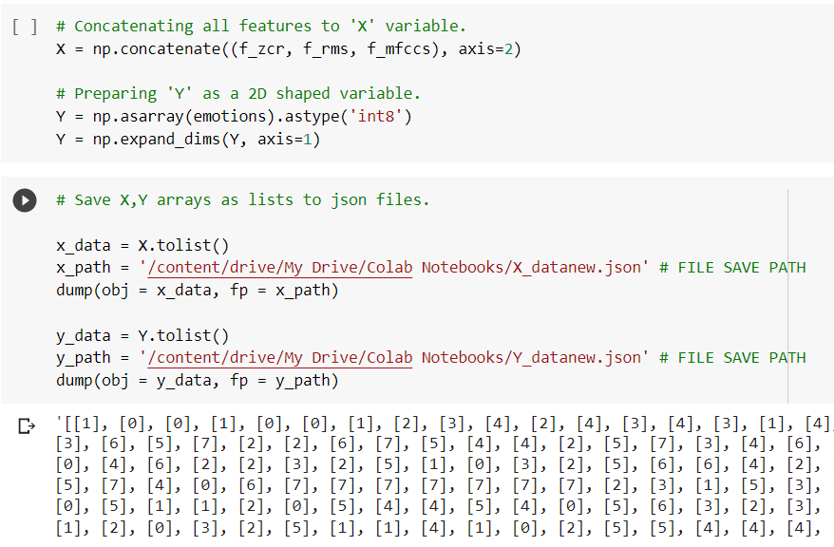
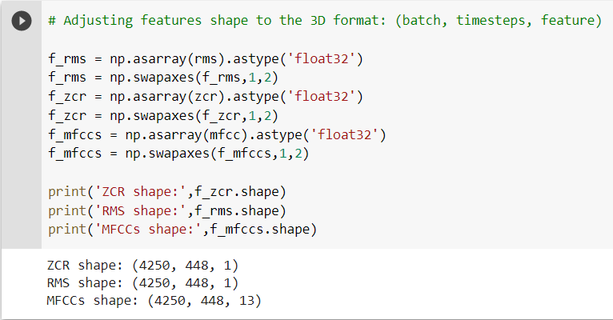
Adjusting features shape to a 3D format
Creating lists X,Y for input features and target

Slide 14
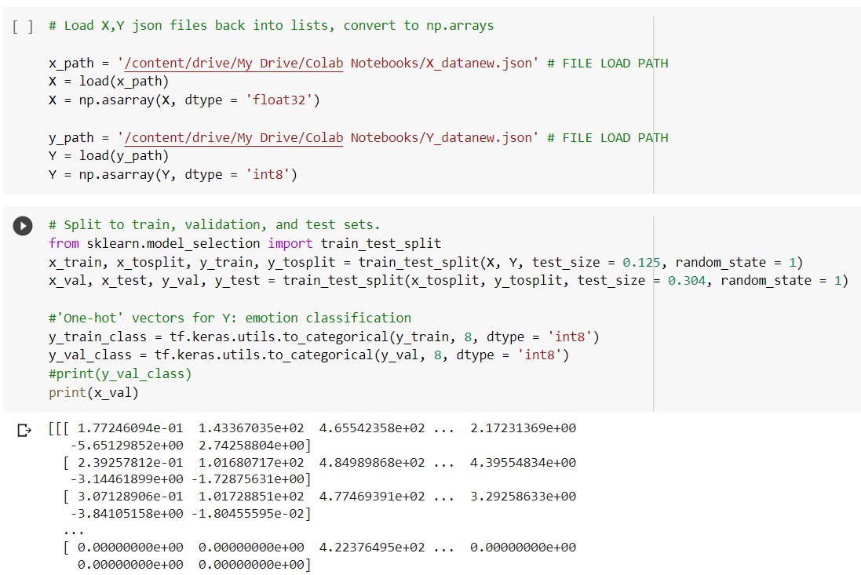
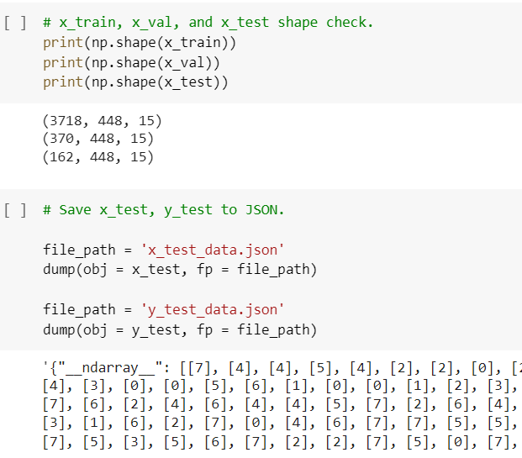
Split data into train, test and validation sets
Saving test data to JSON files

Slide 15
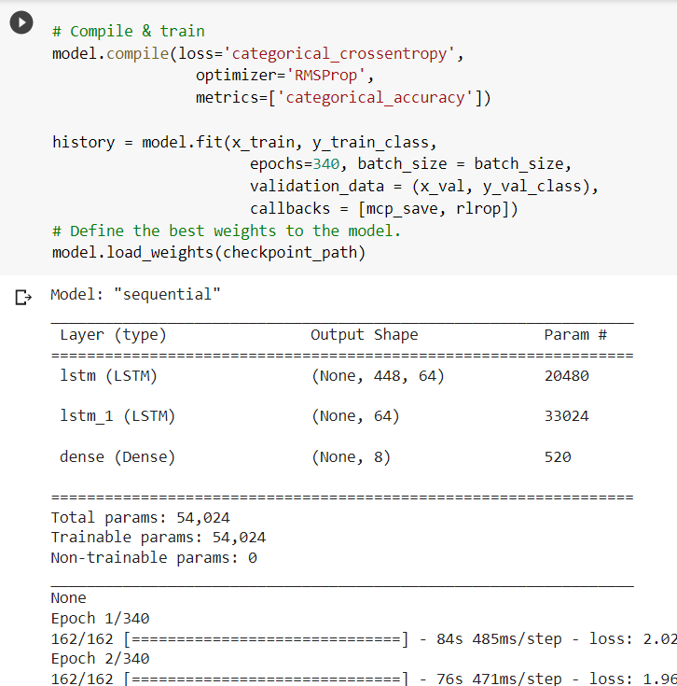
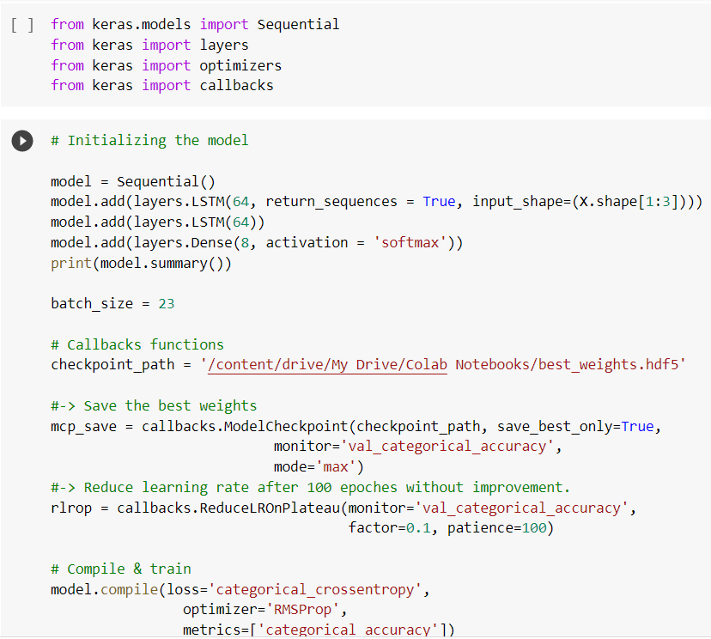
Initializing the model
Compiling and training the model

Slide 16
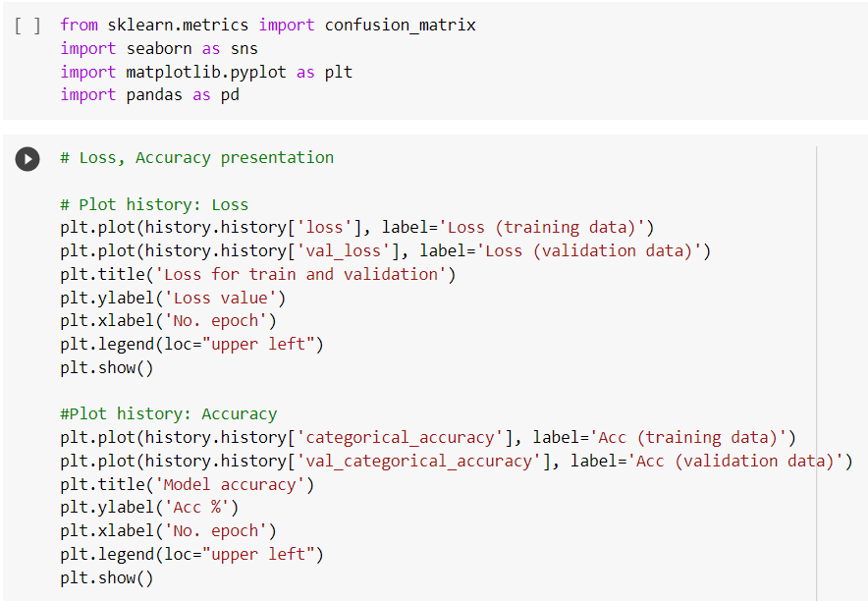
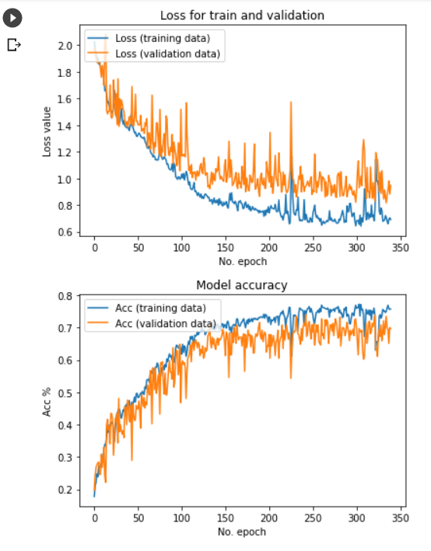
Visualisation of loss and accuracy of the model

Slide 17
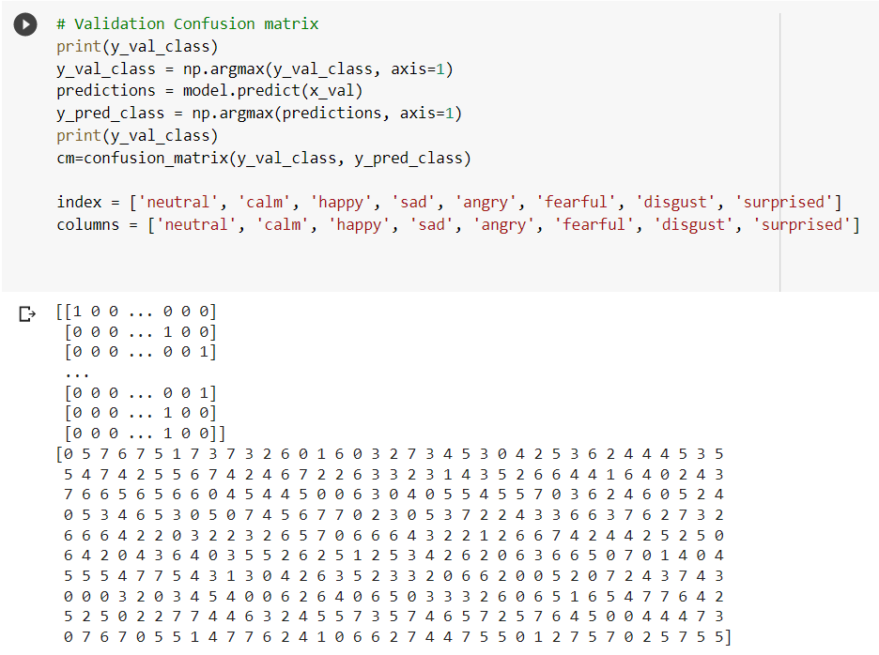
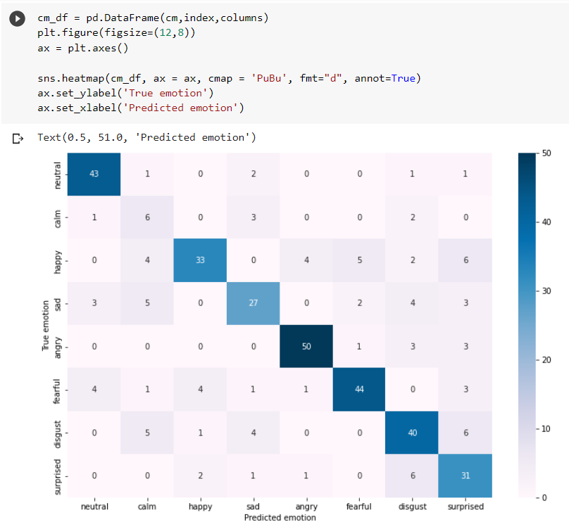
Validation Confusion Matrix
Confusion matrix(True vs Prediction emotions)

Slide 18
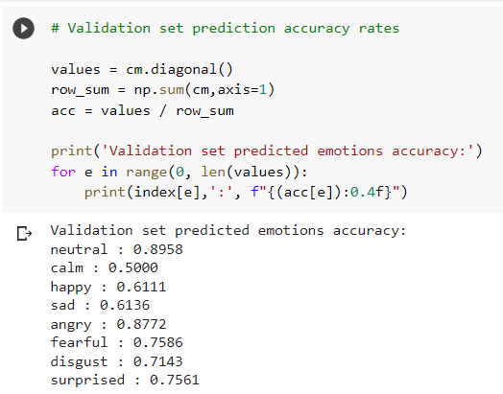
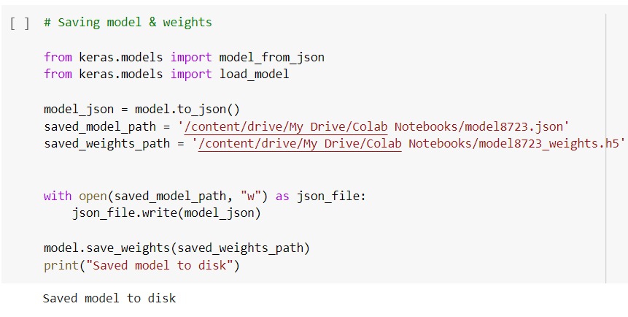
Saving model and weights to disk
Validation set prediction accuracy rates

Slide 19
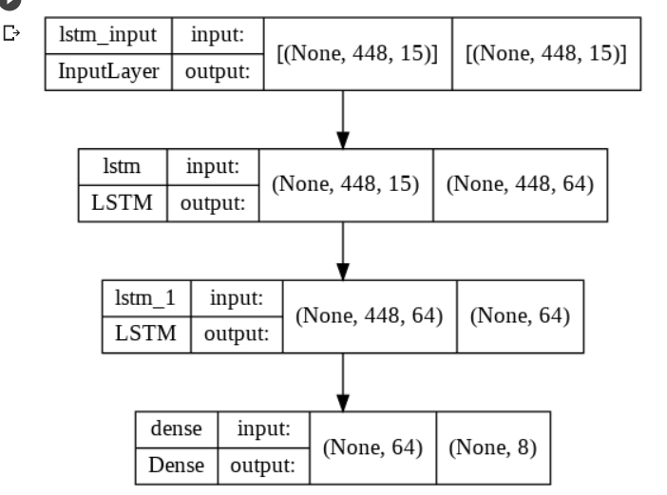
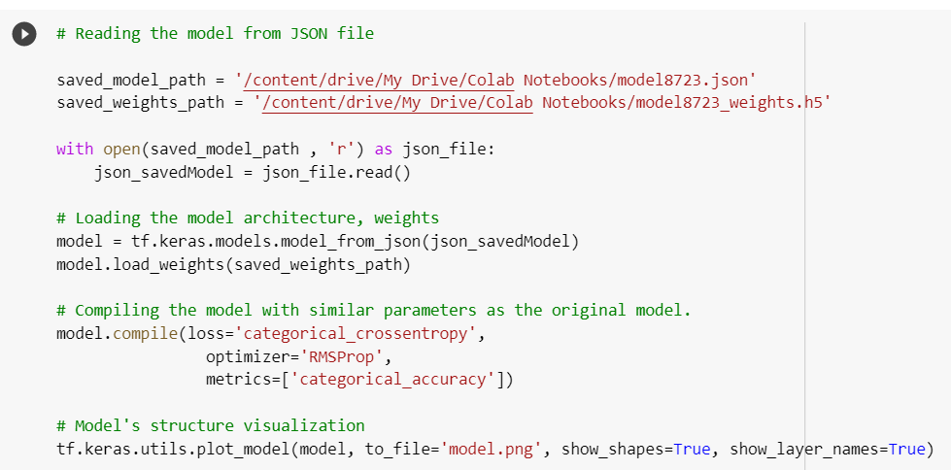
Loading the model architecture and weights from JSON file
Model’s structure visualisation

Slide 20
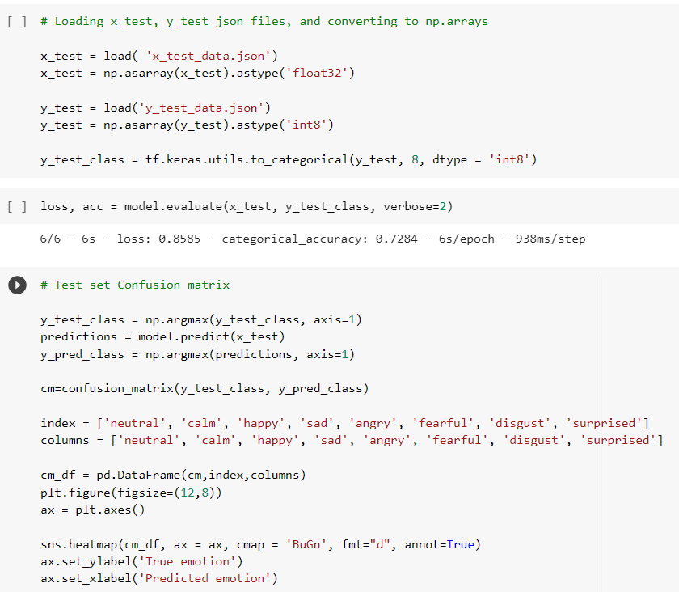
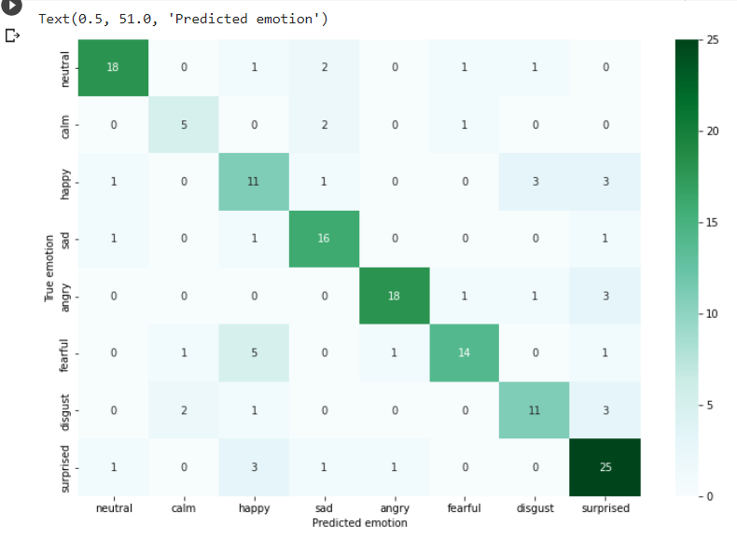
Confusion matrix over the test set

Slide 21
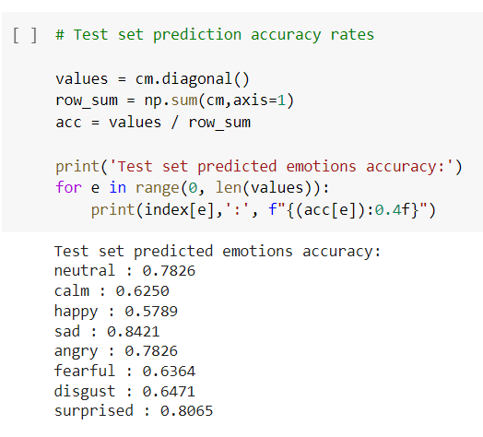
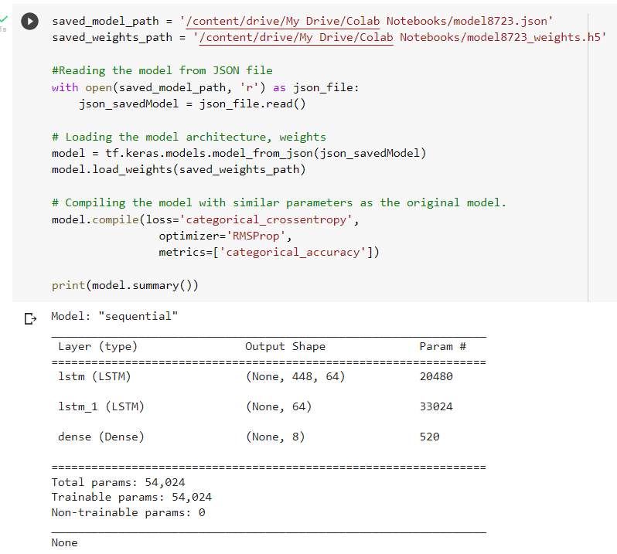
Prediction Accuracy Rates over the Test set
Model Summary

Slide 22
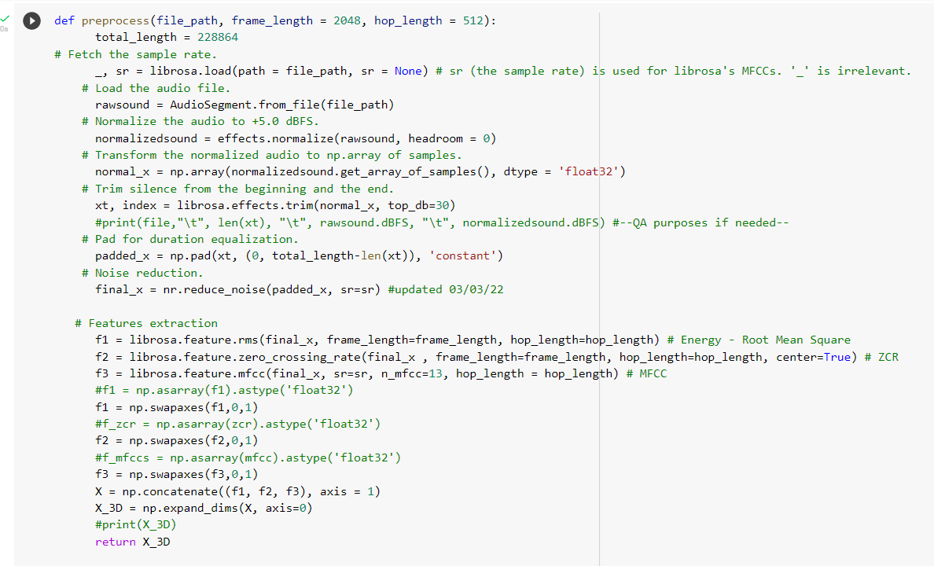
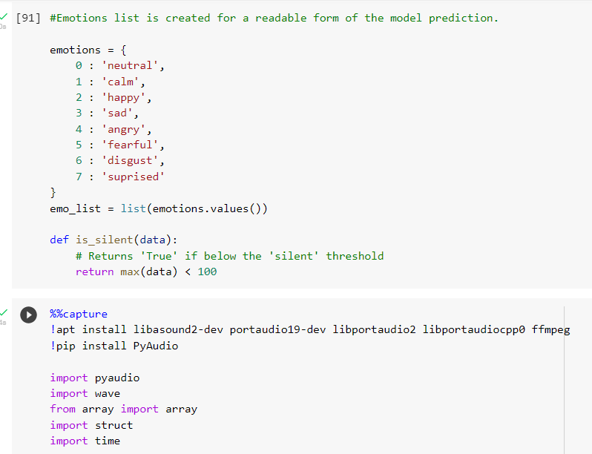
Model Testing
Preprocessing the data
Emotions list for model creation

Slide 23
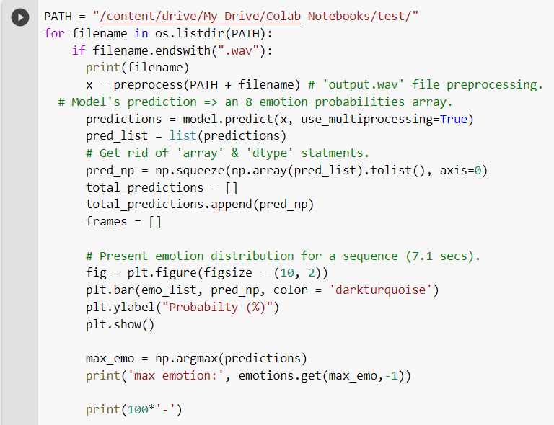
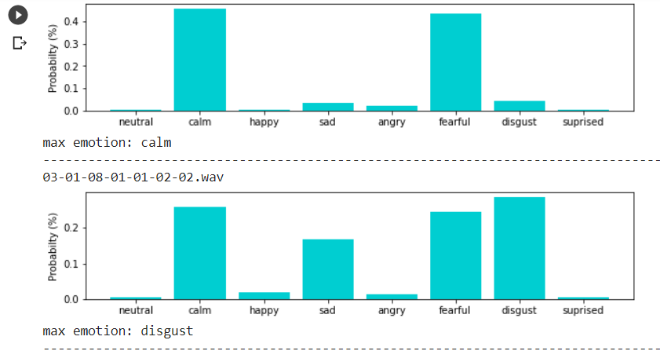
Emotion distribution for voice inputs

Slide 24
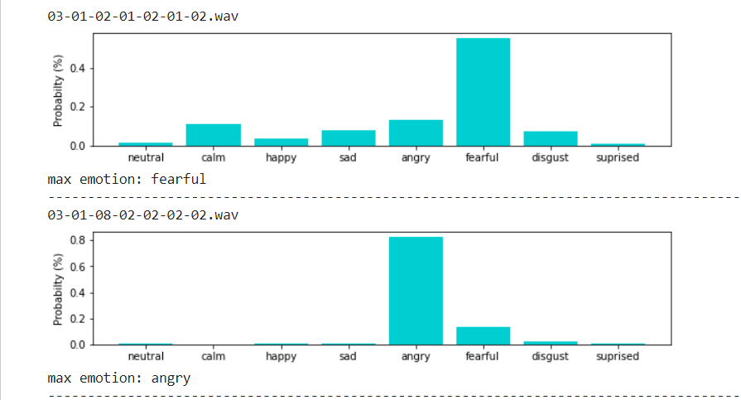
Emotion distribution for voice inputs

Slide 25
THANK YOU

